Slide 1
Practice Question (COCOMO Model):
Consider a Semi-Detached mode​ having 32,000 Delivered Source Instructions. Estimate Effort, duration (schedule), productivity and average staffing?
Software Project | a | b | c | d
Organic | 2.4 | 1.05 | 2.5 | 0.38
Semidetached | 3.0 | 1.12 | 2.5 | 0.35
Embedded | 3.6 | 1.20 | 2.5 | 0.32

Slide 2
Practice Question 1 (COCOMO Model):
Consider a Semi-Detached mode​ having 32,000 Delivered Source Instructions. Estimate Effort, duration (schedule), productivity and average staffing?
Solution:
Effort = a(KLOC)^{b} = 3.0*(32)^{1.12} = 146 man-months​
Schedule = c(E)^{d} = 2.5*(146)^{0.35} = 14 months​
​
Software Project | a | b | c | d
Organic | 2.4 | 1.05 | 2.5 | 0.38
Semidetached | 3.0 | 1.12 | 2.5 | 0.35
Embedded | 3.6 | 1.20 | 2.5 | 0.32

Slide 3
Practice Question 1 (COCOMO Model):
Consider a Semi-Detached mode​ having 32,000 Delivered Source Instructions. Estimate Effort, duration (schedule), productivity and average staffing?
Solution:
Effort, E = a(KLOC)^{b} = 3.0*(32)^{1.12} = 146 man-months​
Nominal Development Time, Schedule (or Duration), D =
c(E)^{d} = 2.5*(146)^{0.35} = 14 months​
Productivity = KLOC/ E = 32 / 146 ​ = 0.219 DSI/MM​
Average Staffing (staff size) = E/D
= 146 MM /14 months ​= 10 Person​ ( or FSP)
FSP stands for Full-time-equivalent Software Personnel.​

Slide 4
Practice Question 1 (COCOMO Model):
Consider a Semi-Detached mode​ having 32,000 Delivered Source Instructions. Estimate Effort, duration (schedule), productivity and average staffing?
Calculate total cost for developing this project if avg salary per developer is Rs. 15,000?

Slide 5
Practice Question 1 (COCOMO Model):
Consider a Semi-Detached mode​ having 32,000 Delivered Source Instructions. Estimate Effort, duration (schedule), productivity and average staffing?
Calculate total cost for developing this project if avg salary per developer is Rs. 15,000?
Duration, D = 14 months​
Cost Required to develop product= D* Avg Salary
= 14 * 15000
=Rs. 2,10,000

Slide 6
Practice Question 2:
A software company is developing a Hospital Management System (HMS) to handle patient records, billing, appointments, and pharmacy integration. The estimated size of the project is 60,000 Delivered Source Instructions (DSI). The project falls into the Semi-Detached mode because it involves a medium-sized team with mixed experience. The cost drivers (EAF multipliers) have been assessed as follows:
Cost Driver | Rating | Multiplier
Product Reliability | High | 1.15
Database Size | Very High | 1.08
Execution Time Constraint | Nominal | 1.00
Analyst Capability | High | 0.86
Programmer Capability | Nominal | 1.00
Use of Software Tools | High | 0.91
Required Development Schedule | Nominal | 1.00
1. Compute the Effort Adjustment Factor (EAF).
2. Using the Intermediate COCOMO model, estimate:
  Effort (in person-months)
  Development Time (in months)
  Productivity (LOC per PM)
  Average Staffing (persons)
Use Semi-Detached constants:
$a=3.0$, $b=1.12$, $c=2.5$, $d=0.35$.

Slide 7
A software company is developing a Hospital Management System (HMS) to handle patient records, billing, appointments, and pharmacy integration. The estimated size of the project is 60,000 Delivered Source Instructions (DSI). The project falls into the Semi-Detached mode because it involves a medium-sized team with mixed experience. The cost drivers (EAF multipliers) have been assessed as follows:
Cost Driver | Rating | Multiplier
Product Reliability | High | 1.15
Database Size | Very High | 1.08
Execution Time Constraint | Nominal | 1.00
Analyst Capability | High | 0.86
Programmer Capability | Nominal | 1.00
Use of Software Tools | High | 0.91
Required Development Schedule | Nominal | 1.00
Solution:
Compute the Effort Adjustment Factor (EAF).
EAF=1.15×1.08×1.00×0.86×1.00×0.91×1.00= 0.97199
2. Using the Intermediate COCOMO model, estimate:
  Effort (in person-months)
Effort (PM) = $\text{EAF}×a×(\text{KLOC}{\left.)\right.}^{b}$
= 0.97199 × 3.0 × 60^{1.12} ≈ 285.96 person-months
Use Semi-Detached constants:
$a=3.0$, $b=1.12$, $c=2.5$, $d=0.35$.

Slide 8
A software company is developing a Hospital Management System (HMS) to handle patient records, billing, appointments, and pharmacy integration. The estimated size of the project is 60,000 Delivered Source Instructions (DSI). The project falls into the Semi-Detached mode because it involves a medium-sized team with mixed experience. The cost drivers (EAF multipliers) have been assessed as follows:
Cost Driver | Rating | Multiplier
Product Reliability | High | 1.15
Database Size | Very High | 1.08
Execution Time Constraint | Nominal | 1.00
Analyst Capability | High | 0.86
Programmer Capability | Nominal | 1.00
Use of Software Tools | High | 0.91
Required Development Schedule | Nominal | 1.00
Solution:
Compute the Effort Adjustment Factor (EAF).
EAF=1.15×1.08×1.00×0.86×1.00×0.91×1.00= 0.97199
2. Using the Intermediate COCOMO model, estimate:
  Effort (in person-months)
Effort (PM) = $\text{EAF}×a×(\text{KLOC}{\left.)\right.}^{b}$
= 0.97199 × 3.0 × 60^{1.12} ≈ 285.96 person-months
  Development Time (in months)
  = $c (\text{Effort}{\left.)\right.}^{d}$ = 2.5×(285.96)^{0.35} ≈ 18.10 months
  Productivity (LOC per PM)
  = $\frac{\text{KLOC}}{\text{Effort}}=\frac{60}{\text{285.96}}$​ ≈ 0.2098 = 209.8 LOC/PM
  Average Staffing (persons)
  = $\frac{\text{Effort}}{\text{Duration}}$ =18.10285.96​ ≈ 15.80 persons
Use Semi-Detached constants:
$a=3.0$, $b=1.12$, $c=2.5$, $d=0.35$.

Slide 9
Practice Question 3:
Functional Units | Weighting factors
 | Low | Average | High
External Inputs (EI) | 3 | 4 | 6
External Output (EO) | 4 | 5 | 7
External Inquiries (EQ) | 3 | 4 | 6
External logical files (ILF) | 7 | 10 | 15
External Interface files (EIF) | 5 | 7 | 10
A bank is developing an online banking application with the following functions:
External Inputs: 10 average (fund transfer, bill payment, login, account update, etc.)
External Outputs: 8 complex (monthly statement, balance summary, loan report, etc.)
External Inquiries: 6 average (mini statement, balance inquiry, loan status, etc.)
Internal Logical Files: 5 complex (Accounts file, Loan file, Customer file, Transaction file, Audit log)
External Interface Files: 4 average (Credit card DB, RBI DB, Payment gateway, ATM switch)
Tasks:
Calculate UFP.
Assume VAF = 1.10, compute AFP.
If average effort = 12 hours per FP, estimate the total effort (hours). Convert this into person-months (assume 1 person-month = 160 hours)

Slide 10
Practice Question 3:
A bank is developing an online banking application with the following functions:
External Inputs: 10 average (fund transfer, bill payment, login, account update, etc.)
External Outputs: 8 complex (monthly statement, balance summary, loan report, etc.)
External Inquiries: 6 average (mini statement, balance inquiry, loan status, etc.)
Internal Logical Files: 5 complex (Accounts file, Loan file, Customer file, Transaction file, Audit log)
External Interface Files: 4 average (Credit card DB, RBI DB, Payment gateway, ATM switch)
Tasks:
Calculate UFP.
UFP = 10 * 4 + 8 * 7 + 6 * 4 + 5 * 15 + 4 * 7 = 223
Functional Units | Weighting factors
 | Low | Average | High
External Inputs (EI) | 3 | 4 | 6
External Output (EO) | 4 | 5 | 7
External Inquiries (EQ) | 3 | 4 | 6
External logical files (ILF) | 7 | 10 | 15
External Interface files (EIF) | 5 | 7 | 10

Slide 11
Practice Question 3:
A bank is developing an online banking application with the following functions:
External Inputs: 10 average (fund transfer, bill payment, login, account update, etc.)
External Outputs: 8 complex (monthly statement, balance summary, loan report, etc.)
External Inquiries: 6 average (mini statement, balance inquiry, loan status, etc.)
Internal Logical Files: 5 complex (Accounts file, Loan file, Customer file, Transaction file, Audit log)
External Interface Files: 4 average (Credit card DB, RBI DB, Payment gateway, ATM switch)
Tasks:
Calculate UFP.
Assume VAF = 1.10, compute AFP (Adjusted Function Point)
AFP (or FP) = UFP × VAF = 223 × 1.10 = 245.3
= 10 * 4 + 8 * 7 + 6 * 4 + 5 * 15 + 4 * 7 = 223

Slide 12
Practice Question 3:
A bank is developing an online banking application with the following functions:
Tasks:
Calculate UFP.
Assume VAF = 1.10, compute AFP (Adjusted Function Point) = UFP × VAF = 223 × 1.10 = 245.3
3. If average effort = 12 hours per FP, estimate the total effort (hours). Convert this into person-months (assume 1 person-month = 160 hours)
= 10 * 4 + 8 * 7 + 6 * 4 + 5 * 15 + 4 * 7 = 223
Total Efforts = AFP × 12 = 245.3 × 12 $=2943.6 \text{hours}$
$$\text{Person}\text{−}\text{months}=\frac{2943.6}{160}=18.3975 \text{PM}$$

Slide 13
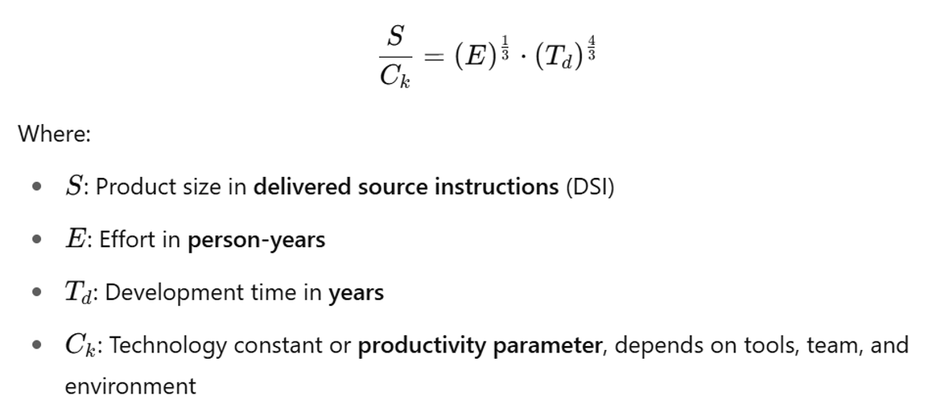
Practice Question-4
Given: $S=10$KLOC, $Ck=6$, $T=1$year.
Find total effort $E$ (person-years) and average staffing (FTE).
Notes:
FTE/ FSP stands for Full-time-equivalent Software Personnel

Slide 14
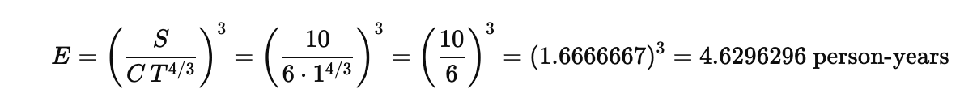
Practice Question-4
Given: $S=10$ KLOC, $Ck=6$, $T=1$year.
Find total effort $E$ (person-years) and average staffing (FTE).
Solution

Slide 15
Practice Question-4
Given: $S=10$KLOC, $Ck=6$, $T=1$year.
Find total effort $E$ (person-years) and average staffing (FTE).
Solution
Notes:
FTE = average number of full-time people working continuously
Person-Months=FTE (average)×Project Duration (months)

Slide 16
Practice Question-5
Given: $S=10$ KLOC, $Ck=6$, $T=1$year.
Find total effort $E$(person-years) and average staffing (FTE).
Management wants delivery in 9 months instead of 12 months (so $T=0.75$yr). Compute the new effort and percent increase vs original plan.

Slide 17
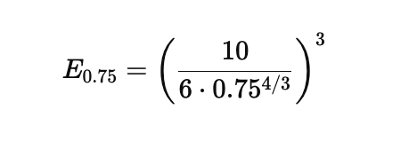
Practice Question-5
Given: $S=10$KLOC, $Ck=6$, $T=1$year.
Find total effort $E$(person-years) and average staffing (FTE).
Management wants delivery in 9 months instead of 12 months (so $T=0.75$yr). Compute the new effort and percent increase vs original plan.
Solution
=14.6319 person-year

Slide 18
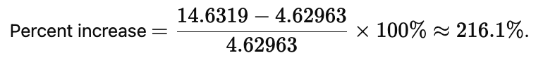
Practice Question-5
Given: $S=10$KLOC, $Ck=6$, $T=1$year.
Find total effort $E$(person-years) and average staffing (FTE).
Management wants delivery in 9 months instead of 12 months (so $T=0.75$yr). Compute the new effort and percent increase vs original plan.
Solution
=14.6319 person-year
Shrinking schedule by 25% more than triples effort (huge cost in manpower).

Slide 19
Practice Question-6
Given $S=15$KLOC, $C=6$, $T=1.2$ years. Compute total effort $E$, average staffing, then approximate peak staffing and time-to-peak.

Slide 20
Practice Question-6
Given $S=15$ KLOC, $C=6$, $T=1.2$ years. Compute total effort $E$, average staffing, then approximate peak staffing and time-to-peak.
Solution
E≈7.535 person-years.
Average staffing = $E/T≈7.535/1.2=6.279$FTE.

Slide 21
Practice Question-6
Given $S=15$ KLOC, $C=6$, $T=1.2$ years. Compute total effort $E$, average staffing, then approximate peak staffing and time-to-peak.
Solution
E≈7.535 person-years.
Average staffing = $E/T≈7.535/1.2=6.279$FTE.
Rayleigh-type staffing profiles for SLIM usually peak before delivery. QSM/ SLIM docs often use a peak location ~40–45% of the development duration and a peak level roughly 1.2–1.5× the average (exact shape depends on chosen Rayleigh parameters).

Slide 22
Practice Question-6
Given $S=15$ KLOC, $C=6$, $T=1.2$ years. Compute total effort $E$, average staffing, then approximate peak staffing and time-to-peak.
Solution
E ≈ 7.535 person-years.
Average staffing = $E/T≈7.535/1.2=6.279$FTE.
Rayleigh-type staffing profiles for SLIM usually peak before delivery. QSM/ SLIM docs often use a peak location ~40–45% of the development duration and a peak level roughly 1.2–1.5× the average (exact shape depends on chosen Rayleigh parameters).
Using 45% and a factor 1.4:
Peak time $≈0.45×1.2=0.54$ years (≈ 6.5 months).
Peak staffing ≈ $1.4 × 6.279≈8.79$FTE.

Slide 23
Practice Question- 7
Take $S=10$ KLOC and $T=1$ year. Compute $E$for two different $C$values:
$C=4$ (worse process) and $C=8$ (better process).

Slide 24
Practice Question-7
Take $S=10$KLOC and $T=1$year. Compute $E$ for two different $C$values:
$C=4$(worse process) and $C=8$(better process).
Solution
For C=4: E≈15.625 person-years.
For C=8: E≈1.953 person-years.
Doubling $C$ dramatically reduces required effort.

Slide 25
Practice Question-8
Budget at Completion (BAC) = ₹20, 00,000.
At month 6: Planned % complete = 50%
  Planned Value (PV) = 50% × BAC.
Actual Cost (AC) so far = ₹12, 00,000.
Actual physical progress = 40%
  Earned Value (EV) = 40% × BAC.
Compute CV, SV, CPI, SPI, EAC, and ETC.

Slide 26
Practice Question-8 : Solution
Planned Value (PV) = 0.50 × 20,00,000 = ₹10, 00,000.
Earned Value (EV) = 0.40 × 20,00,000 = ₹8,00,000.
Actual Cost (AC) = ₹12,00,000 .
Cost Variance (CV) = EV − AC
    = 800,000 − 1,200,000 = −₹400,000 (over budget).
Schedule Variance (SV) = EV − PV
= 800,000 − 1,000,000 = −₹200,000
(behind schedule).
Cost Performance Index (CPI) = EV / AC
= 800,000 / 1,200,000 = 0.6667.

Slide 27
Practice Question-8 : Solution
Planned Value (PV) = 0.50 × 20,00,000 = ₹10, 00,000.
Earned Value (EV) = 0.40 × 20,00,000 = ₹8,00,000.
Actual Cost (AC) = ₹12,00,000 .
Cost Variance (CV) = −₹400,000
Schedule Variance (SV) = −₹200,000
Cost Performance Index (CPI) = 0.6667.
Schedule Performance Index (SPI) = EV / PV
= 800,000 / 1,000,000 = 0.8.
Estimate at Completion (EAC) = BAC / CPI
= 2,000,000 / 0.6667 ≈ ₹3,000,000.

Slide 28
Practice Question-8 : Solution
Planned Value (PV) = 0.50 × 20,00,000 = ₹10, 00,000.
Earned Value (EV) = 0.40 × 20,00,000 = ₹8,00,000.
Actual Cost (AC) = ₹12,00,000 .
Cost Variance (CV) = −₹400,000
Schedule Variance (SV) = −₹200,000
Cost Performance Index (CPI) = 0.6667.
Schedule Performance Index (SPI) = 0.8.
Estimate at Completion (EAC) = ₹3,000,000.
Estimate to Complete (ETC) = EAC − AC
= 3,000,000 − 1,200,000 = ₹1,800,000.

